Slide 1

CSE 350 Digital Electronics and Pulse Techniques
Diode Logic
Course Instructor: Shomen Kundu (SDU)
Mail: shomen.kundu@bracu.ac.bd
Desk: 4N166

Slide 2
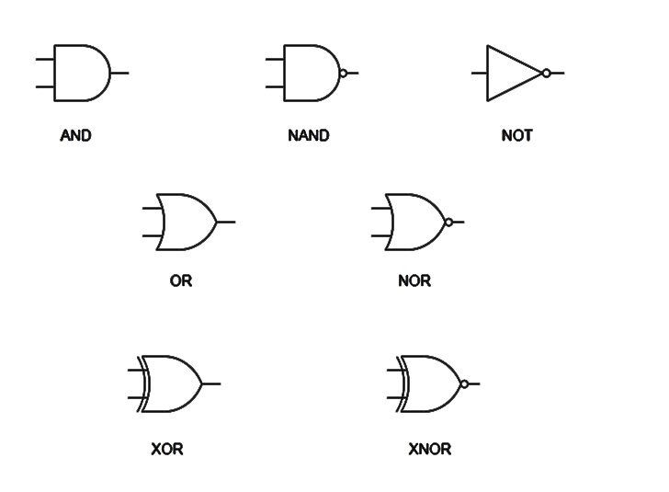
Abstract of Logic Gate:
This gates are abstract, because they just represent logical operations.

Slide 3
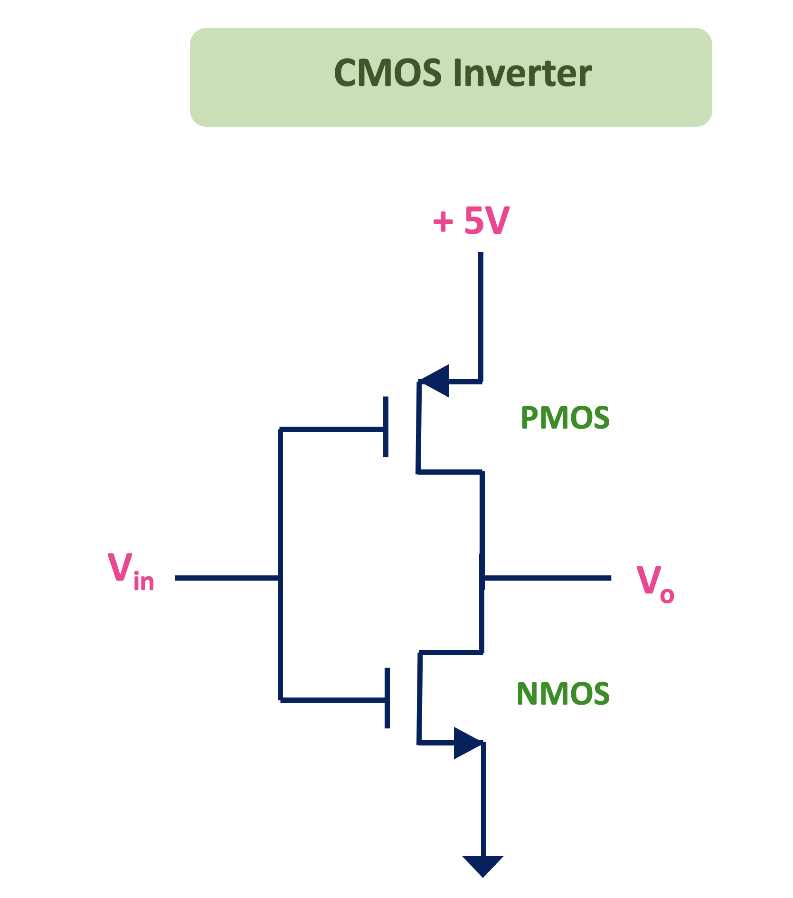
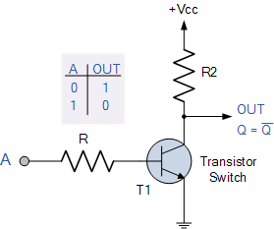
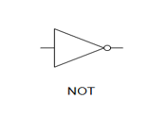
Logic families

Slide 4
Logic families
Digital Logic Families
Bipolar logic families
(electron and hole both are used as charge carrier)
Example: BJTs
Unipolar logic families
(Only one type of charge carrier dominates)
Example: MOSFET, JFET
i. PMOS logic families
ii. NMOS logic families
iii. CMOS logic families
Saturated
(saturation and Cutoff)
Unsaturated
(Active & Cutoff)

Slide 5
Logic families
Saturated Logic Family: Uses Saturation & Cutoff region of a BJT for implementation of logic states.
Resistor Transistor Logic (RTL)
Diode Transistor Logic (DTL)
Direct Coupled Transistor Logic (DCTL)
Integrated Injection Logic (IIL)
High Threshold Logic (HTL)
Transistor-Transistor Logic (TTL)
Unsaturated Logic Family: Uses Active & Cutoff region of a BJT for implementation of logic states.
Schottky TTL
Emitter Coupled Logic (ECL)

Slide 6
Logic families
Unipolar Logic Family: JFET, MOSFET etc. single charge carrier-based transistor logic families.
PMOS Logic Family
NMOS Logic Family
CMOS Logic Family

Slide 7
Diode logic
OR gate and AND gate Design Techniques,
For each input we need a series resistance and a diode
Output will be connected with GND or VDD
For OR gate output will be connected to the GND via pull down resistance
For AND gate output will be connected to the VDD via pull up resistance.
Series resistance will be small.
Pull up / Pull down resistance will be large.

Slide 8
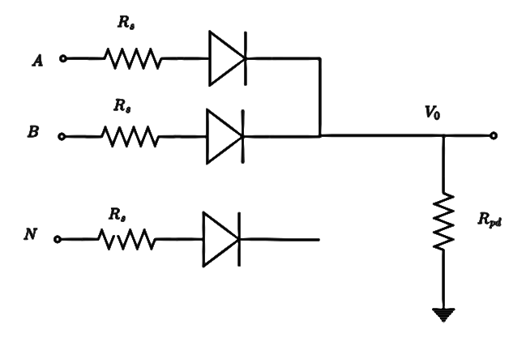

Diode logic
OR Gate
Series and pull down
resistance can be chosen as
$$R_{s}=1 kΩ$$
$$R_{pd}=100 kΩ$$

Slide 9
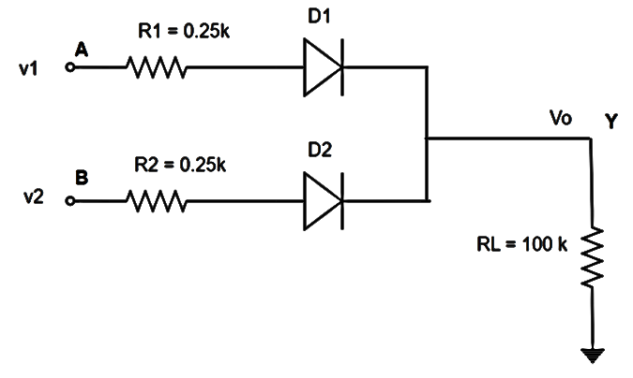
Diode logic
Two input OR Gate
A | B | V1 | V2 | Vo | Y
0 | 0 | 0V | 0V
0 | 1 | 0V | 5V
1 | 0 | 5V | 0V
1 | 1 | 5V | 5V
Assume: Logic 1 means 5 V on input side. Logic 0 means 0 voltage/GND

Slide 10
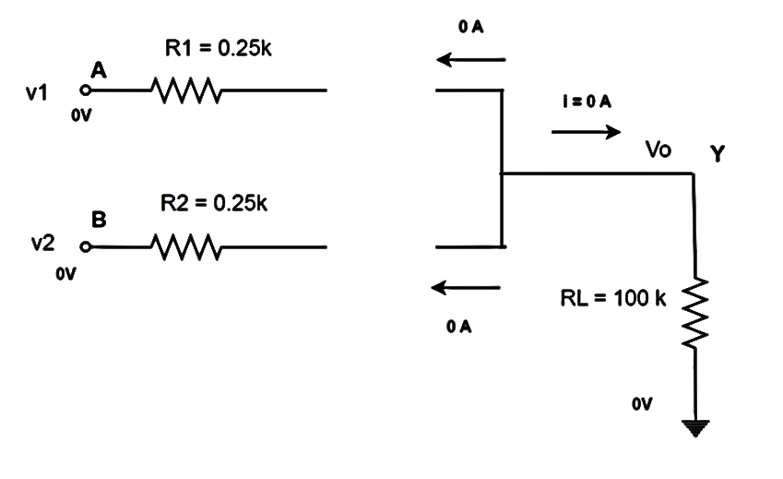


Diode logic
Case 1: A = 0, B = 0
First thing to check whether diodes are on or off.
FACT: We need at least 0.7 V to turn on any diode.
Conclusion: D1 and D2 are OFF.
$$\frac{Vo −0}{RL}=i=0 =>Vo=0 V$$
$$Y=0 ( logic)$$

Slide 11
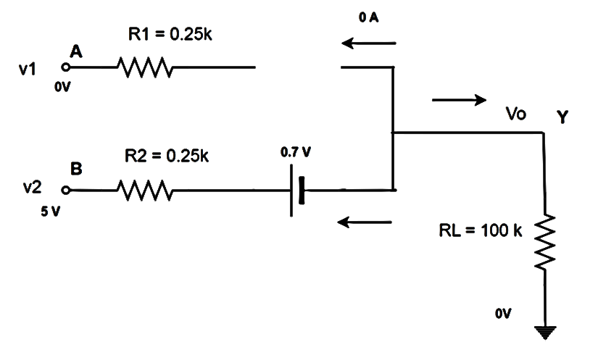
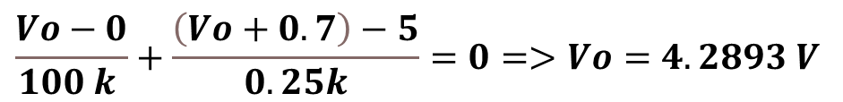

Diode logic
Case 2: A = 0, B = 1
First thing to check whether diodes are on or off.
# Here: D1 will be OFF and D2 will be ON
$$\frac{Vo−0}{100 k }+\frac{\left(Vo+0.7\right)−5}{0.25k}=0=>Vo=4.2893 V$$
$$Y=1 ( logic)$$

Slide 12
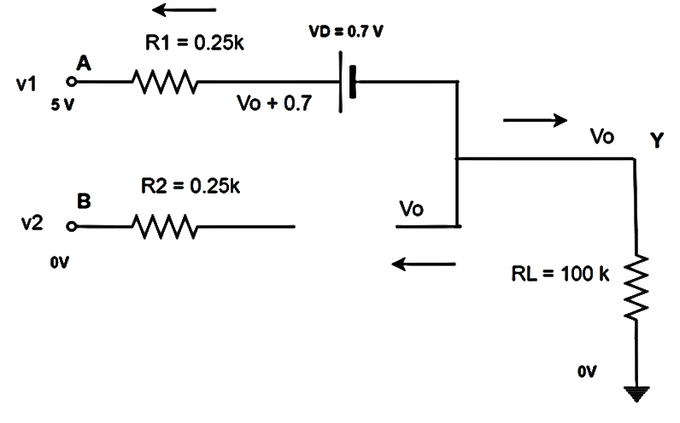


Diode logic
Case 3: A = 1, B = 0 ( symmetrical to case 1 )
First thing to check whether diodes are on or off.
# Here: D1 will be ON and D2 will be OFF
$$\frac{Vo−0}{100 k }+\frac{\left(Vo+0.7\right)−5}{0.25k}=0=>Vo=4.2893 V$$
$$Y=1 ( logic)$$

Slide 13
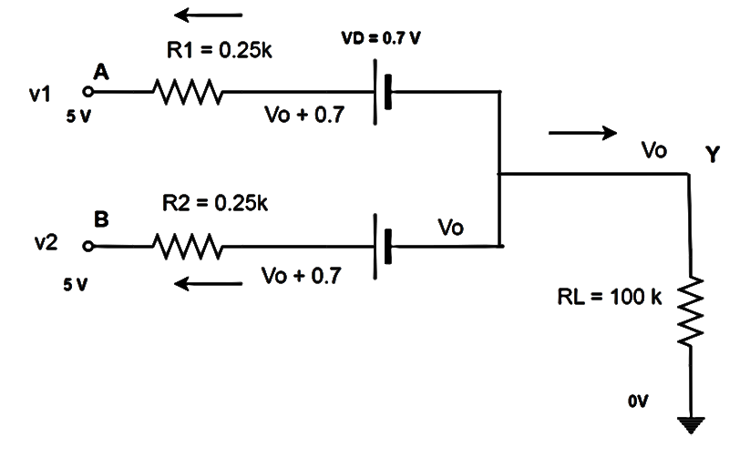
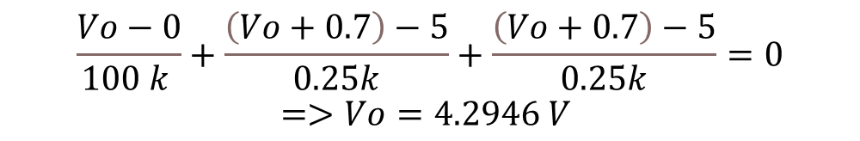

Diode logic
Case 4: A = 1, B = 1
First thing to check whether diodes are on or off.
# Here: D1 will be ON and D2 will be ON
$$\frac{Vo−0}{100 k }+\frac{\left(Vo+0.7\right)−5}{0.25k}+\frac{\left(Vo+0.7\right)−5}{0.25k}=0$$
$$=>Vo=4.2946 V$$
$$Y=1 ( logic)$$

Slide 14
Diode logic
A | B | V1 | V2 | Vo | Y
0 | 0 | 0V | 0V | 0 V | 0
0 | 1 | 0V | 5V | 4.2893V | 1
1 | 0 | 5V | 0V | 4.2893V | 1
1 | 1 | 5V | 5V | 4.2946 V | 1
Two input OR Gate Findings
#4.28 V , 4.29 V
# logical High and Low can be
Different at input and output side
VOH = 4.28 V
( lowest of the outputs values
that can be considered as logic 1 )

Slide 15
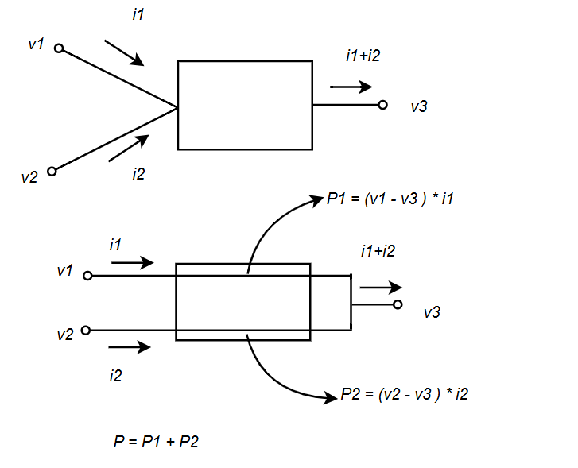
Power Dissipation Calculation
Theory:

Slide 16
Max Power Dissipation
Example: Find the max power dissipation of the given circuit.

Slide 17
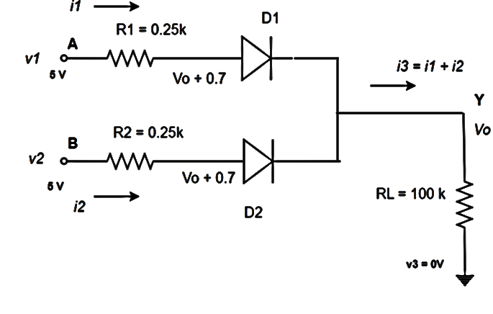

Max Power Dissipation
Max power dissipation will be in the case 4
$$V_{0}=4.2946 V$$
$$i1= \frac{5−( V_{0}+0.7)}{0.25 k}=0.0216 mA$$
$$i2=i1$$
$$i_{3}=\frac{V_{0}−0}{100k}=0.042946 mA$$
$$P=\left(5−0\right)∗i_{1}+\left(5−0\right)∗i_{2}= 0.216 mW$$
Or $P=\left(5−0\right)∗i_{3}=0.216 mW$

Slide 18
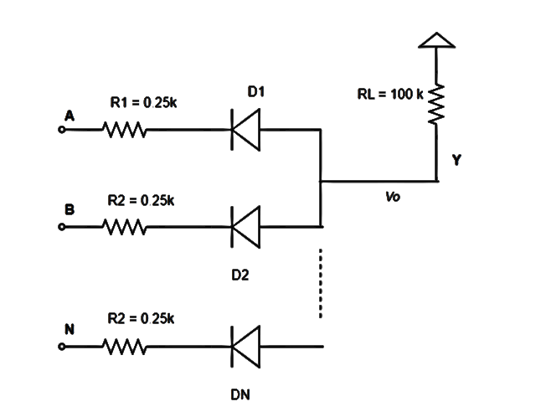
Diode logic
AND gate:

Slide 19
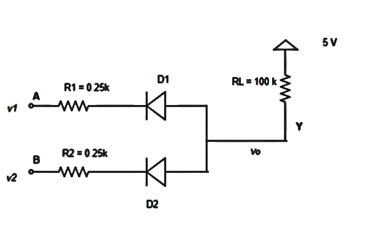
Diode logic
Exercise: Analysis the four possible input and fill the table. Also find the V_{OL} for this circuit.
A | B | V1 | V2 | Vo | Y
0 | 0 | 0V | 0V
0 | 1 | 0V | 5V
1 | 0 | 5V | 0V
1 | 1 | 5V | 5V
Hints: Logical low voltage at the output side --→ Highest voltage for which the output is considered to be 0 or logic low.

Slide 20
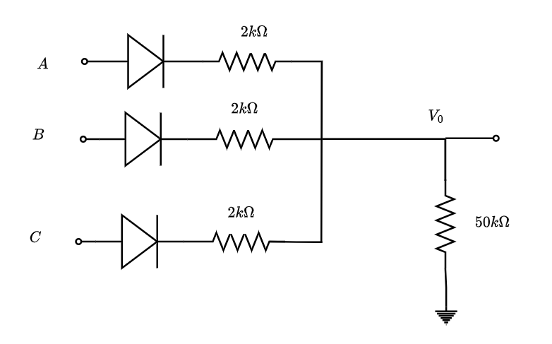

Diode logic
Try yourself,
1. Design a logic circuit, $Y=A\left(B+C\right)$ using diode logic.
2. For the given circuit find the maximum
power and average power.

